Slide 1
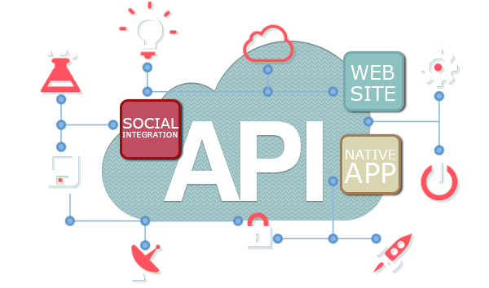
How I Think About URI’s
Wladymir Brborich

Slide 2
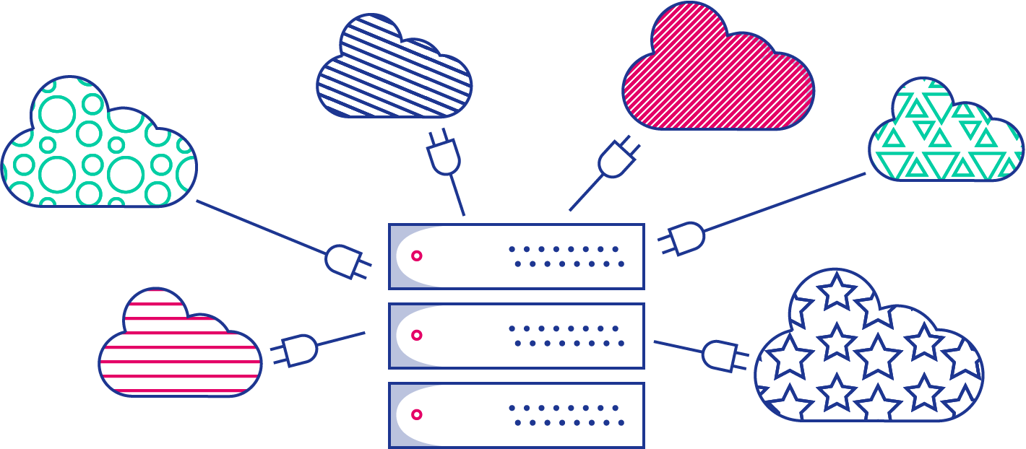
What is an URI
Uniform Resource Identifier
It is the way we access resources on a system
In lamer terms: is how we ask the server what we want

Slide 3

Why consider design at all?
Proper naming is important in every aspect of the development process
Following patterns will ease the API consumption and implementation
You waste less time going through the manifest or documentation
Makes your team happy
Back end is the core of the project

Slide 4
The guidelines I follow
Proper naming of the data I want to send or receive
Design a serialized data scheme (JSON, XML, Plain Text)
Have a list of actions which use that particular piece of data
Think what those actions want to accomplish
Comparing what the actions do with HTTP methods
Implement the actions as functions based on the most similar HTTP method
Name the URI
Note: This is my personal take, you may want to research and read more.

Slide 5

How to actually compare actions against HTTP methods
For a general rule of thumb you can say:
Use GET to retrieve data from the server, or execute a function which does not need actual user data.
Use POST to send data to the server, usually when you want to execute a function which needs more than one individual value
Use PUT to update a piece of data, but mainly if you are using a database
Use DELETE to remove a piece of data from the server, usually from a database

Slide 6
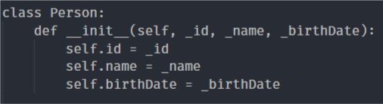
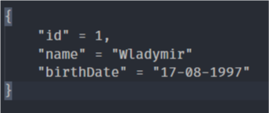
To Illustrate my point
Proper naming of the data I want to send or receive
Design a serialized data scheme (JSON, XML, Plain Text)

Slide 7
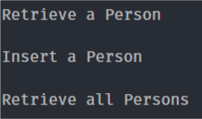
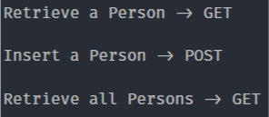
Have a list of actions which use that particular piece of data
Think what those actions want to accomplish
Make a call to our storage, save or return pieces of data
Comparing them to HTTP Methods

Slide 8
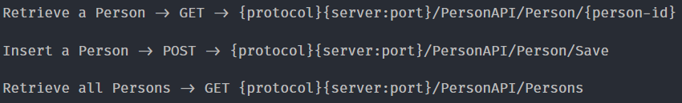
Naming the URI’s
You can go further an research how RESTFULL api URI’s are named.

